Slide 1
Lecture 4
Data Analytics Lifecycle

Slide 2
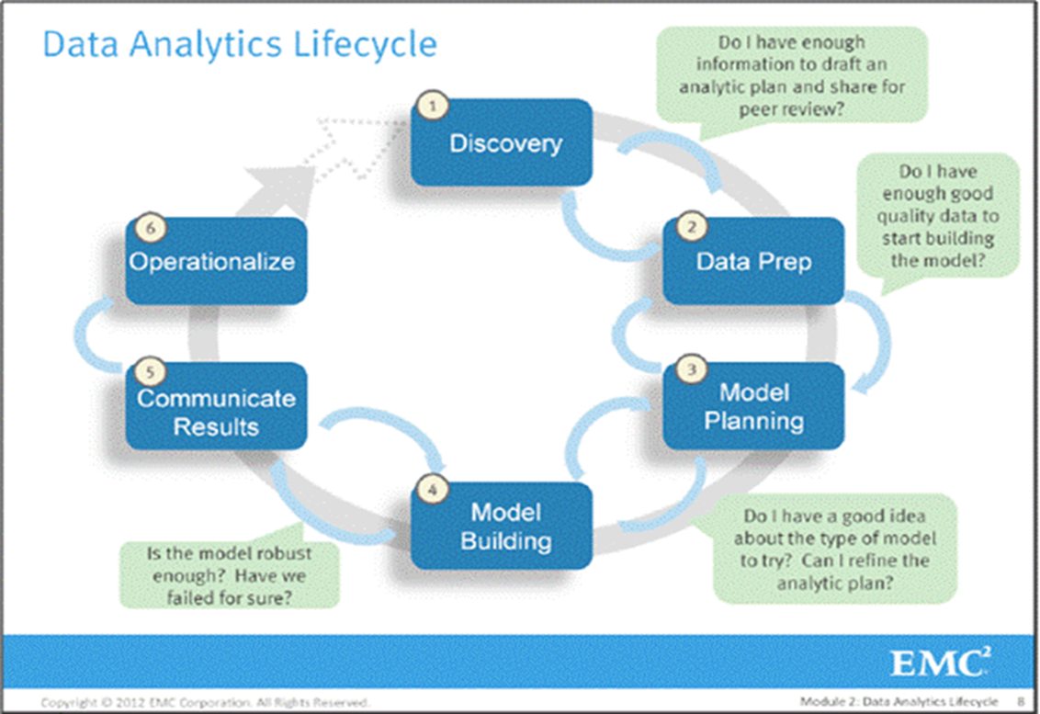
Data Analytics Lifecycle
Phase 1: Discovery
Phase 2: Data Preparation
Phase 3: Model Planning
Phase 4: Model Building
Phase 5: Communicate Results
Phase 6: Operationalize
Source: EMC Data Analytics Handbook

Slide 3
Data Analysis vs. Data Analytics
Data analytics is a broader term
may refer to the complete business process of data analysis project
data analysis usually considered as a subcomponent of data analytics
Data analysis refers to the process of compiling and analyzing data to support decision making
Whereas data analytics also includes the tools and techniques use to do so
Sometime we use these two terms interchangeably when referring to data science projects in general

Slide 4
Process Overview
The data analytic lifecycle mainly designed for
big data problems
data science projects
It’s an iterative process
Along the process new information/data may be uncovered
This lecture only discusses general idea of each phase of the lifecycle; the following lectures will discuss how to perform the specific tasks in selected phases.

Slide 5
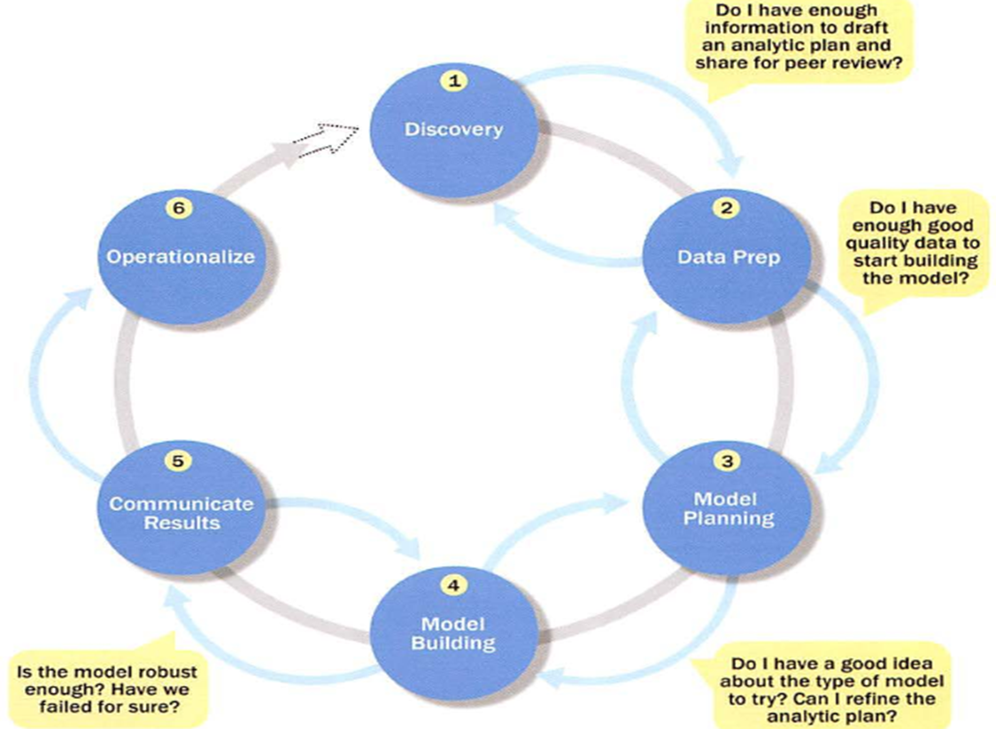
Walking through the lifecycle

Slide 6
Case Studies
Using two application cases:
Fitbit's 150 billion hours of heart data reveal secrets about health
Project Talent Test
Activity -- Students report on the (reading) assignment: selected groups brief on what the papers talk about?

Slide 7
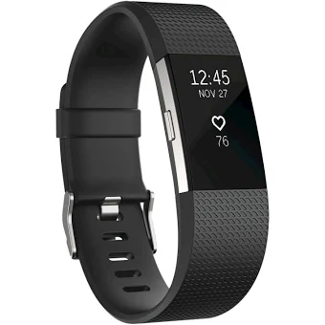
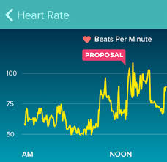

Fitbit Project
Check out the Fitbit community (https://community.fitbit.com) for any Fitbit related questions including how to download Fitbit heart rate data

Slide 8
Project Talent Test
the largest survey of American teenagers ever done
In 1960, about a half-million teens took a test.
Now it could predict the risk of Alzheimer’s disease.

Slide 9
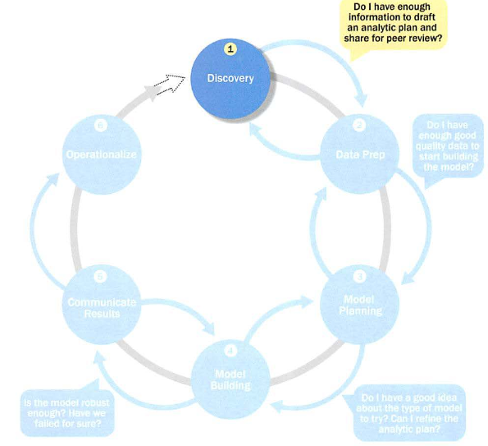
Phase 1: Discovery

Slide 10
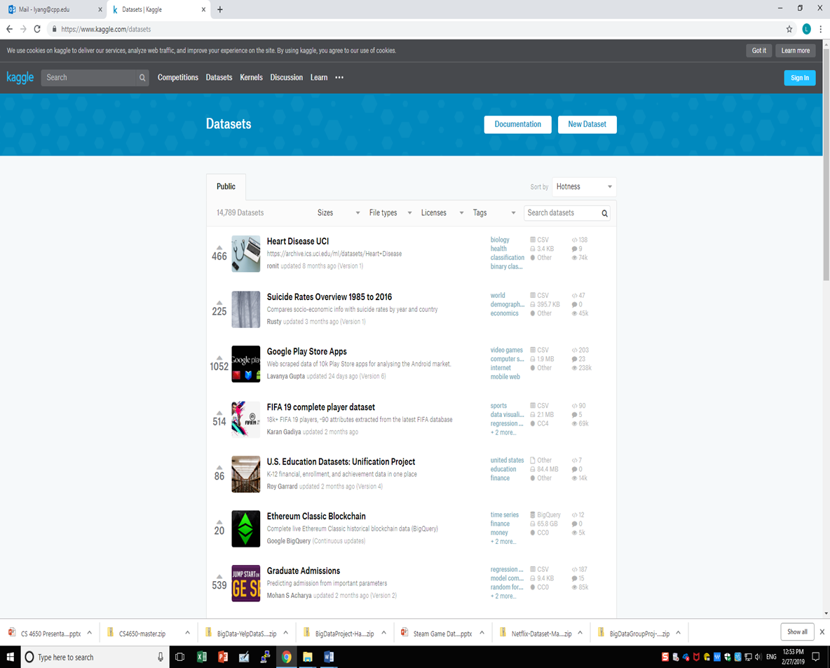
Data Discovery Techniques
From Data Services
Example
https://www.kaggle.com/datasets

Slide 11
Activity #1
Name another data services that host many varieties of big data sets.
(Recall assignment #1 or find new ones.)

Slide 12
Using APIs
Application Program Interfaces (APIs) are commonly used to retrieve data from remote websites. Sites like Reddit, Twitter, and Facebook all offer certain data through their APIs. To use an API, you make a request to a remote web server, and retrieve the data you need.
Python API tutorial
https://www.dataquest.io/blog/python-api-tutorial/
Using software tools
Activity #2: Explore Yelp api
What data sets available there? Sizes of datasets?

Slide 13
Common Tools of Acquiring Big Data
Data collection from system logs
Chukwa (Hadoop), Flume (Cloudera), Scribe (Facebook), …
Data collection from Internet
Web Scraper, API published by sites
…
Mobile data collection
APP is an effective way

Slide 14
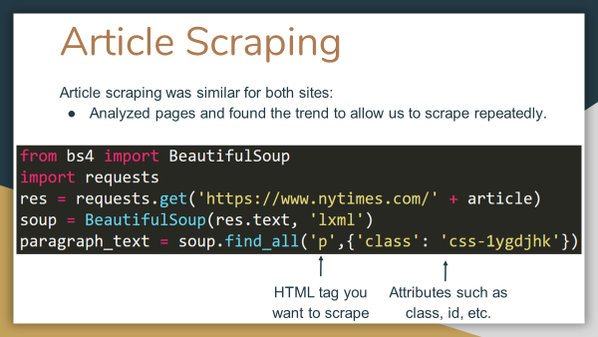
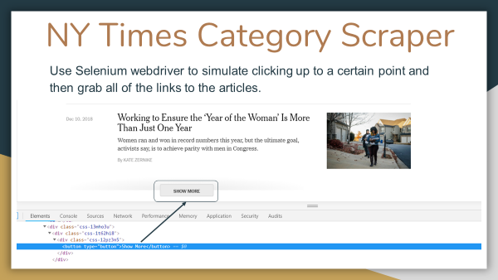
Web Scraper
Web scraping is the process of extracting data from websites. A piece of code, called a “scraper” first sends a “GET” query to a specific website. Then, it parses an HTML document based on the received result. After it’s done, the scraper searches for the data you need within the document, and, finally, converts it into the specified format.
Python web scraping tutorial
https://realpython.com/tutorials/web-scraping/

Slide 15
Activity #3
Compare and contrast the Fitbit and Talent Test cases
Assume you were the data analyst for both projects, answer the questions with your imagination:
How data collected?
For Talent Test project, pay attention to the time span of data collection
What specific data are collected?
Use your imagination to describe specific data contents and format.
Make sure you are able to draw results from the data collected.
What techniques/tools you’d use to collect the data?

Slide 16
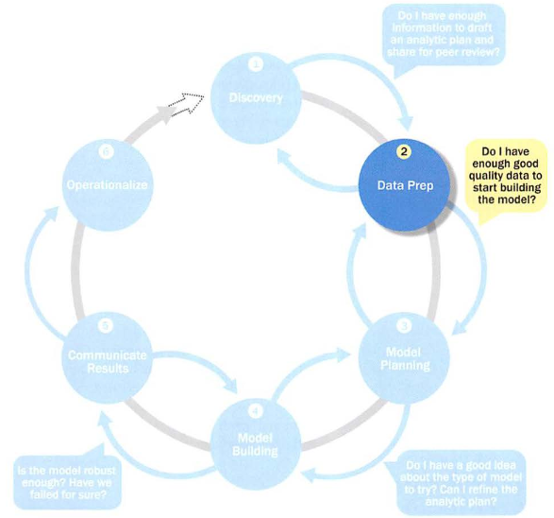
Phase 2: Data Preparation

Slide 17
Phase 2: Data Preparation
Explore, preprocess, and condition data
Including data cleansing/cleaning, data wrangling, etc.
Cleansing and cleaning are used interchangeably
These techniques will be discussed in the following slides
Create robust environment – analytics sandbox
It’s the most labor-intensive step in the analytics lifecycle
Often at least 50% of the data science project’s time
Generally the most iterative

Slide 18
Data (Pre)Processing
Why preprocessing
Data-gathering methods are often loosely controlled, resulting in out-of-range values (e.g., Income: −100), impossible data combinations (e.g., Theme park: Disney, City: Pomona), missing values, …
Analyzing data that has not been carefully screened for such problems can produce misleading results.
Thus, we need quality data before analyzing
Data preprocessing includes cleaning, wrangling, …
Cleaning: removing erroneous values, handling missing values, …
Wrangling: changing data from one format to another, …

Slide 19
Data Cleaning/Cleansing
The process of amending or removing data in a database that is incorrect, incomplete, improperly formatted, or duplicated ...
Using a data cleaning tool can save a database administrator a significant amount of time and can be less costly than fixing errors manually.
Research project: Handling missing values in big data sets.

Slide 20
Data Wrangling
The process of transforming and mapping data from one "raw" data form into another format with the intent of making it more appropriate and valuable for a variety of downstream purposes such as analytics.
Transforming semi-structured/quasi-structure/unstructured data to structured data

Slide 21
From Unstructured to Structured: Data Wrangling
How to do it? Text/information retrieval – a subject in data mining, not discussed here

Slide 22
Data Conditioning
Data conditioning is the use of data management and optimization techniques which result in the intelligent routing, optimization and protection of data for storage or data movement in a computer system.
Make data “smooth”
e.g. applying a noise filter so that the signal is stronger.

Slide 23

Common Tools for Data Preparation
Hadoop can perform parallel ingest and analysis.
https://hadoop.apache.org/
OpenRefine (formerly Google Refine) is a free, open source tool for working with messy data.
Similar to OpenRefine, Stanford’s Data Wrangler is an interactive tool for data cleaning an transformation.
…

Slide 24
Activity #4
For the Fitbit case
What kind of values (use your imagination) would be considered as errors?
How erroneous data could be introduced? (i.e. name sources of errors)
For the Talent Test case
Are the data collected 55 years later complete?
What could be further done to make the Talent Test data more useful?

Slide 25
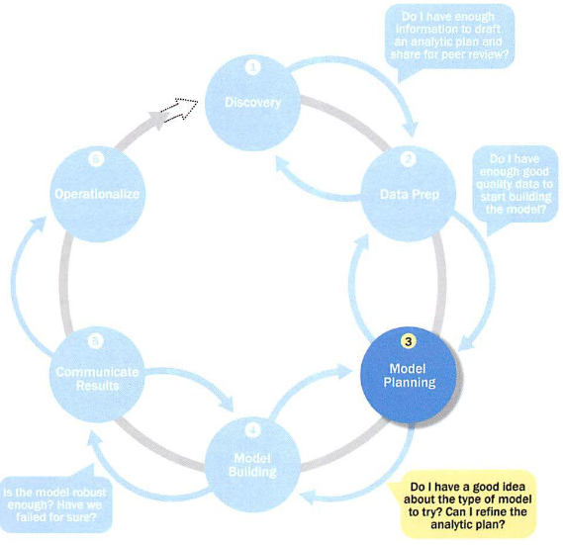
Phase 3: Model Planning

Slide 26
Phase 3: Model Planning
Key activity: Assess the structure of the data
this dictates the tools and analytic techniques (next phase)
Ensure the analytic techniques are feasible
Determine if the situation warrants a single model or a series of techniques
Research and understand how other analysts have approached this kind or similar kind of problem
Require deep understanding of the science in subject/application area
Some fields (e.g. weather forecast) involve advanced scientific methods (Meteorology includes atmospheric chemistry and atmospheric physics)

Slide 27
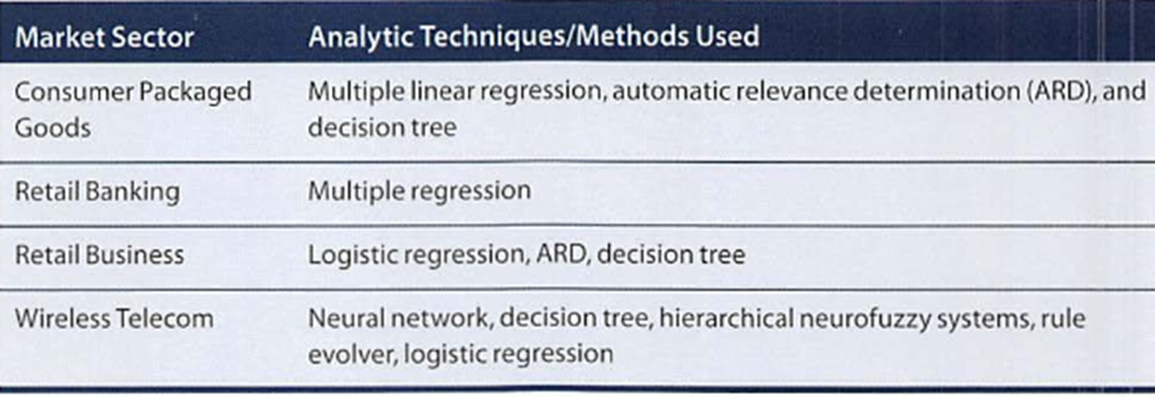
Model Planning: Examples

Slide 28
Common Tools for Data Modeling
R has a complete set of modeling capabilities
R contains about 5000 packages for data analysis and graphical presentation
SQL Analysis services can perform in-database analytics of common data mining functions
SAS/ACCESS provides integration between SAS and the analytics sandbox via multiple data connections
Top 6 popular modeling tools
https://www.datasciencecentral.com/profiles/blogs/top-6-data-modeling-tools

Slide 29

Activity #5: Brainstorming
What model are used for the Fitbit data analysis?
What model are used for the Talent Test data analysis?
Weather forecast (use your knowledge or imagination)
What data needed to forecast tomorrow’s weather? How to collect? (phase 1)
Possible to have errors in these collected data? How to clean? What data format likely for original data when collected? Is such format easy to process? If not, how to convert to another format? (phase 2)
From the data we have, how could we predict tomorrow’s weather? What scientific model would be used? (phase 3)
Earthquake data
What can you do with the given data relating to southern California earthquakes? (see lecture demo for earthquake data.)

Slide 30
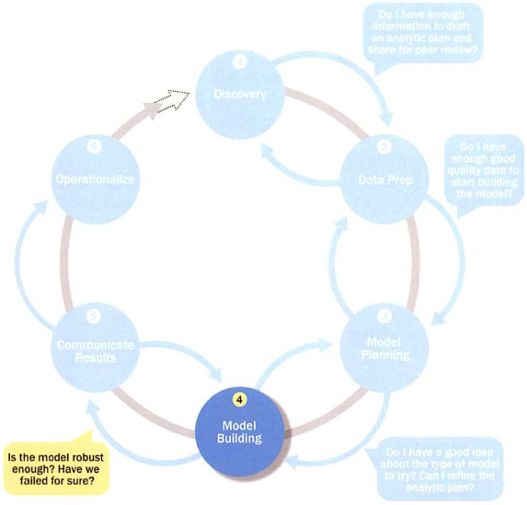
Phase 4: Model Building

Slide 31
Phase 4: Model Building
Execute the models defined in Phase 3.
Develop datasets for training, testing, and production.
Develop analytic model on training data, test on test data.
Phase 3 and Phase 4 are domain specific; In this lecture, we simply consider Phase 3 as the design phase while Phase 4 as the implementation (and testing) phase.

Slide 32
Common Tools for Model Building
Commercial Tools
SAS Enterprise Miner – built for enterprise-level computing and analytics
SPSS Modeler (IBM) – provides enterprise-level computing and analytics
Matlab – high-level language for data analytics, algorithms, data exploration
Alpine Miner – provides GUI frontend for backend analytics tools
STATISTICA and MATHEMATICA – popular data mining and analytics tools
Free or Open Source Tools
R and PL/R - PL/R is a procedural language for PostgreSQL with R
Octave – language for computational modeling
WEKA – data mining software package with analytic workbench
Python – language providing toolkits for machine learning and analysis
SQL – in-database implementations provide an alternative tool

Slide 33
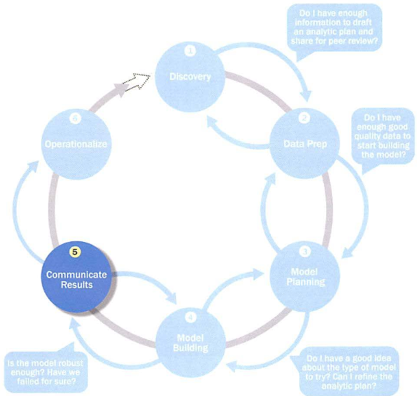
Phase 5: Communicate Results

Slide 34
Phase 5: Communicate Results
Determine if the team succeeded or failed in its objectives
You are ready to receive your team project grade!
Assess if the results are statistically significant and valid
If so, identify aspects of the results that present salient findings
Identify surprising results and those in line with the hypotheses
Communicate and document the key findings and major insights derived from the analysis
This is the most visible portion of the process to the outside stakeholders and sponsors
Determine project success/failure

Slide 35
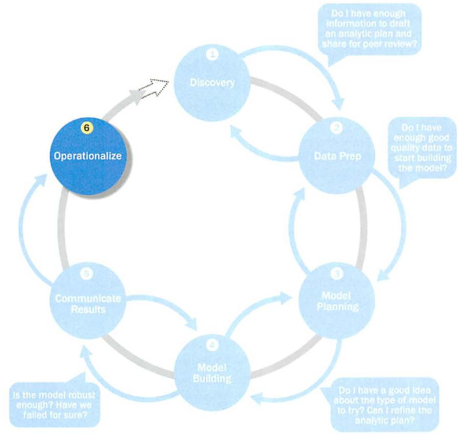
Phase 6: Operationalize

Slide 36
Phase 6: Operationalize Key outputs: Deliverables
Business user – tries to determine business benefits and implications
Project sponsor – wants business impact, risks, ROI
Project manager – needs to determine if project completed on time, within budget, goals met
Business intelligence analyst – needs to know if reports and dashboards will be impacted and need to change
Data engineer and DBA – must share code and document
Data scientist – must share code and explain model to peers, managers, stakeholders

Slide 37
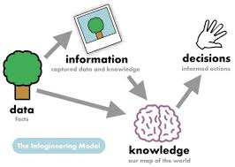
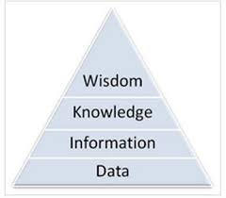
Delivering Results
Key point
Delivering information not data to stakeholders
From data to information
Visualization: a very important tool
Phase 5 and Phase 6 seems more important to business/management level; in our discussion we may combine these two phases and focus on how to exhibit our results with visualization.

Slide 38
Activity #6
Compare and contrast the Fitbit and Talent Test cases, what differs in delivering the results? i.e.
How does the Fitbit data analysis project show the analysis result?
How does the Talent Test data analysis project describe the analysis result?

Slide 39
Summary
Data Analytics Lifecycle (combined view)
Data discovery/collection
Data preprocessing
Model: design and implementation
Delivering/exhibiting results
Next lecture
Introduction to NumPy and Pandas
Challenges and Opportunities (optional)
Examine each phase to look for challenges and discover opportunities.
Assignment
Find a big data application, draft key points for each phase of data analytics for this application, i.e. for the data set you found in Assignment #1, what you can do (specifically) with this data set?

